Slide 1
Training in the Faith: The Early Christian Catechumenate
West Coast Pastors Conference
May 2-6, 2011

Slide 2
I. Introduction
The Major Question
The Major Assumption
The Purpose
The Metaphor: “Third Race”
The Argument:
A clear alternative
Pressure
Training: I Tim.4:7-8; I Cor. 9:25-27; Phil. 3:12-14; Col. 1: 28-29; Heb. 12:1-2
Catechumenate
Terms
Third Race: example (The So-Called Letter to Diognetus)

Slide 3
Introduction
Lewis: “Every age has its own outlook. It is specially good at seeing certain truths and specially liable to make certain mistakes. We all, therefore, need the books [or ideas, practices, etc.] that will correct the characteristic mistakes of our own period. And that means old books. All contemporary writers share to some extent the contemporary outlook—even those, like myself, who seem most opposed to it. . . . We may be sure that the characteristic blindness of the twentieth century . . . lies where we have never suspected it . . . . None of us can fully escape this blindness, but we shall certainly increase it, and weaken our guard against it, if we read only modern books. Where they are true they will give us truths which we half knew already. Where they are false they will aggravate the error with which we are already dangerously ill. The only palliative is to keep the clean sea breeze of the centuries blowing through our minds, and this can be done only by reading old books. Not, of course, that there is any magic about the past. People were no cleverer then than we are now; they made as many mistakes as we. But not the same mistakes. They will not flatter us in the errors we are already committing; and their own errors, being now open and palpable, will not endanger us. Two head are better than one, not because either is infallible, but because they are unlikely to go wrong in the same direction.”

Slide 4
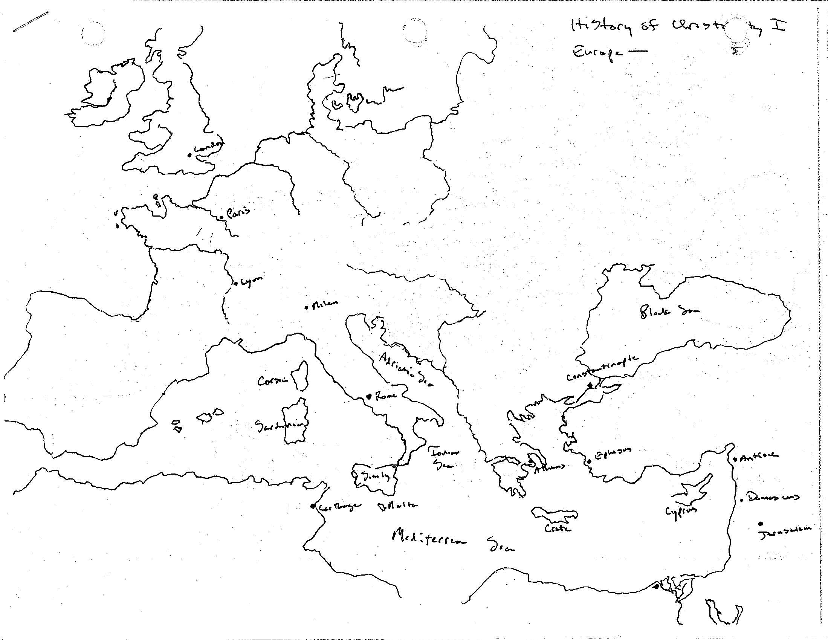

Slide 5
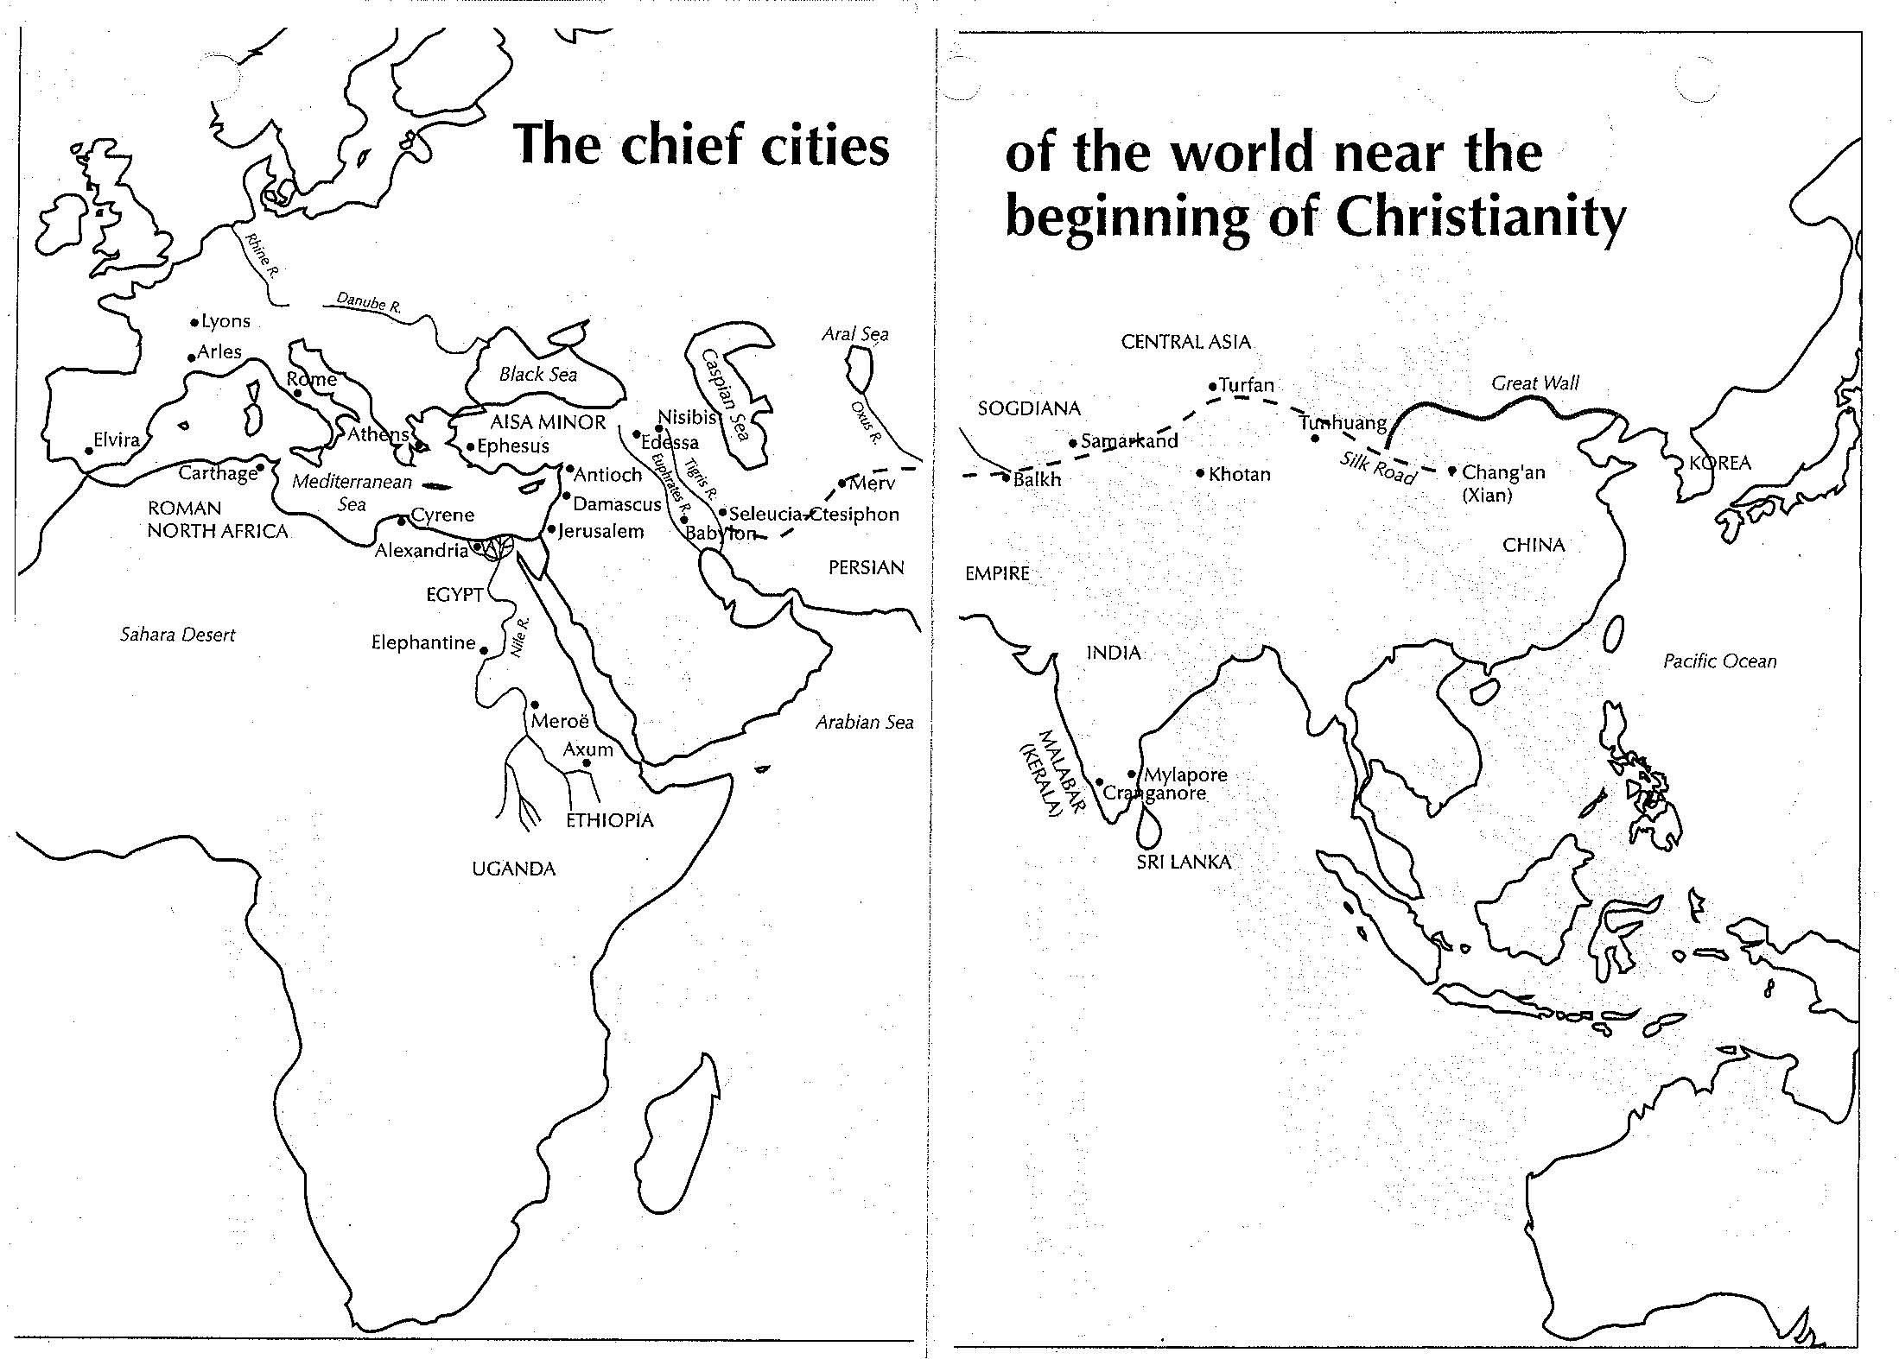

Slide 6
The So-Called Epistle to Diognetus
“I understand, sir, that you are really interested in learning about the religion of the Christians, and that you are making an accurate and careful investigation of the subject. You want to know, for instance, what God they believe in and how they worship him, while at the same time they disregard the world and look down on death, and how it is that they do not treat the divinities of the Greeks as gods at all, although on the other hand they do not follow the superstition of the Jews. You would also like to know the source of the loving affection that they have for each other. You wonder, too, why this new race [or “third race”] or way of life has appeared on earth now and not earlier. . . . . Now, then, clear out all thoughts that take up your attention, and pack away all the old ways of looking at things that keep deceiving you. You must become like a new man from the beginning, since, as you yourself admit, you are going to listen to a really new message.”

Slide 7
The So-Called Epistle to Diognetus
“For Christians cannot be distinguished from the rest of the human race by country or language or custom. They do not live in cities of their own; they do not use a peculiar form of speech; they do not follow an eccentric manner of life. This doctrine of theirs has not been discovered by the ingenuity or deep thought of inquisitive men, nor do they put forward a merely human teaching, as some people do. Yet, although they live in Greek and barbarian cities alike, as each man’s lot has been cast, and follow the customs of the country in clothing and food and other matters of daily living, at the same time they give proof of the remarkable and admittedly extraordinary constitution of their own commonwealth. They live in their own countries, but only as aliens. They have a share in everything as citizens, and endure everything as foreigners. Every foreign land is their fatherland, and yet for them every fatherland is a foreign land. They marry, like everyone else, and they beget children, but they do not cast out their offspring. They share their board with each other, but not their marriage bed. It is true that they are ‘in the flesh,’ but they do not live ‘according to the flesh.’ They busy themselves on earth, but their citizenship is in heaven. They obey the established laws, but in their own lives they go far beyond what the laws require. They love all men, and by all men are persecuted. They are unknown, and still are condemned; they are put to death, and yet they are brought back to life. They are poor, and yet they enjoy complete abundance. They are dishonored, and in their very dishonor are glorified; they are defamed, and yet vindicated. . . . They are treated by the Jews as foreigners and enemies, and are hunted down by the Greeks; and all the time those who hate them find it impossible to justify their enmity.”

Slide 8
The So-Called Epistle to Diognetus
“He sent him by whom all things have been set in order and distinguished and placed in subjection—the heavens and the things that are in the heavens, the earth and the things in the earth, the sea and the things in the sea, fire, air, the unfathomable pit, the things in the heights and in the depths and in the realm between; God sent him to men. Now, did he send him, as a human mind might assume, to rule by tyranny, fear, and terror? Far from it! He sent him out of kindness and gentleness, like a king sending his son who is himself a king. He sent him as God; he sent him as man to men. He willed to save man by persuasion, not by compulsion, for compulsion is not God’s way of working. In sending him, God called men, but did not pursue them; he sent him in love, not in judgment.”
“He himself gave up his own Son as a ransom for us—the holy one for the unjust, the innocent for the guilty, the righteous one for the unrighteous, the incorruptible for the corruptible, the immortal for the mortal. For what else could cover our sins except his righteousness? . . . The sinfulness of many is hidden in the Righteous One, while the righteousness of the One justifies the many that are sinners. In the former time he had proved to us our nature’s inability to gain life; now he showed the Savior’s power to save even the powerless, with the intention that on both counts we should have faith in his goodness, and look on him as Nurse, Father, Teacher, Counselor, Healer, Mind, Light, Honor, Glory, Might, Life—and that we should not be anxious about clothing and food.”

Slide 9
The So-Called Epistle to Diognetus
“To be happy does not, indeed, consist in lording it over one’s neighbors, or in longing to have some advantage over the weaker ones, or in being rich and ordering one’s inferiors about. It is not in this way that any man can imitate God, for such things are alien to his majesty. But if a man takes his neighbor’s burden on himself, and is willing to help his inferior in some respect in which he himself is better off, and, by providing the needy with what he himself possesses because he has received it from God, becomes a god to those who receive it—then this man is an imitator of God. Then, while your lot is cast on earth, you will realize that God rules in heaven; then you will begin to talk of the mysteries of God; then you will love and admire those who are being punished for their refusal to deny God; then you will condemn the fraud and error of the world, once you really understand the true life in heaven, once you look down on the apparent death here below, once you fear the real death kept for those who are condemned to the eternal fire, which will punish in the end those that are handed over to it.”

Slide 10
II. Examples of Training in Early Texts
Early Texts: Didache, I Clement, Letters of Ignatius, Epistle of Polycarp, Martyrdom of Polycarp
Early Apologists: Diognetus, Justin Martyr, Athenagoras, Aristides, Clement of Alexandria, Tertullian, Origen
Bishops: Cyprian, Ambrose of Milan, Athanasius, Basil of Caesarea, Gregory of Naziansus, Gregory of Nyssa, Cyril of Jerusalem, Theodore of Mopsuestia, John Chrysostom, Augustine of Hippo
Early example: The Didache and the “Two Ways”

Slide 11
Justin Martyr: First Apology
“I will also relate the manner in which we dedicated ourselves to God when we had been made new through Christ; lest, if we omit this, we seem to be unfair in the explanation we are making. As many are persuaded and believe that what we teach and say is true, and undertake to be able to live accordingly, are instructed to pray and to entreat God with fasting, for the remission of their sins that are past, we praying and fasting with them. Then they are brought by us where there is water, and are regenerated in the same manner in which we were ourselves regenerated. For, in the name of God, the Father and Lord of the universe, and of our Savior Jesus Christ, and of the Holy Spirit, they then receive the washing with water. . . . But we, after we have thus washed him who has been convinced and has assented to our teaching, bring him to the place where those who are brethren are assembled, in order that we may offer hearty prayers in common for ourselves and for the baptized [illuminated] person, and for all others in every place, that we may be counted worthy, now that we have learned the truth, by our works also to be found good citizens and keepers of the commandments, so that we may be saved with an everlasting salvation.”

Slide 12
Clement of Alexandria: Paedegogus
“The instructor being practical, not theoretical, His aim is thus to improve the soul, not to teach, and to train it up to a virtuous, not an intellectual life. . . . There is a wide difference between health and knowledge; for the latter is produced by learning, the former by healing. One, who is ill, will not therefore learn any branch of instruction till he is quite well.” “And there is one mode of training for philosophers, another for orators, and another for athletes; so is there a generous disposition, suitable for the choice that is set upon moral loveliness, resulting from the training of Christ. And in the case of those who have been trained according to this influence. Their gait in walking, their sitting at table, their food, their sleep, their going to bed, their regimen, and the rest of their mode of life, acquire a superior dignity. For such a training as is pursued by the Word is not overstrained, but is of the right tension.”

Slide 13
Tertullian: To the Martyrs
“In like manner, O blessed ones, count whatever is hard in this lot of yours as a discipline of your power of mind and body. You are about to pass through a noble struggle, in which the living God acts the part of the superintendent, in which the Holy Ghost is your trainer, in which the prize is an eternal crown of angelic essence, citizenship in the heavens, glory everlasting. Therefore your Master, Jesus Christ, who has anointed you with His Spirit, and led you forth to the arena, has seen it good, before the day of conflict, to take you from a condition more pleasant in itself, and has imposed on you a harder treatment, that your strength might be the greater. For the athletes, too, are set apart to a more stringent discipline, that they may have their physical powers built up. They are kept from luxury, from daintier meats, from more pleasant drinks; they are pressed, racked, worn out; the harder their labors in the preparatory training, the stronger is the hope of victory. . . . We, with the crown eternal in our eye, look upon the prison as our training-ground, that at the goal of final judgment we may be brought forth well disciplined by many a trial; since virtue is built up by hardships, as by voluptuous indulgence it is overthrown.”

Slide 14
Origen
“When you abandon the darkness of idolatry and when you desire to arrive at the knowledge of the divine law, then begin your departure from Egypt. When you have been accepted into the crowd of the catechumens and when you have begun to obey the commandments of the Church, you have crossed the Red Sea. In the halts of the desert, each day, you apply yourself to listening to the law of God and to contemplate the visage of Moses which discloses the glory of the Lord. When you arrive at the spiritual spring of baptism and when in the presence of the sacerdotal and levitical order you will be initiated into these venerable and sublime mysteries that are only known by those who have the right to know them; then, having crossed the Jordan, thanks to the ministry of the priests, you will enter in the land of promise, this land where Jesus, after Moses, takes you in charge and becomes the guide for your new path.”

Slide 15
Ambrose: catechetical sermons
“Can an athlete enjoy leisure once he has given in his name for an event? No, he trains and is anointed every day. He is given special food; discipline is imposed on him; he has to keep himself chaste. You too have given in your name for Christ’s contest; you have entered for an event, and its prize is a crown. Practice, train, anoint yourself with the oil of gladness, an ointment that is never used up. Your food should be frugal, without intemperance or self-indulgence. Your drink should be more sparing for fear drunkenness should catch you unawares. Keep your body chaste so as to be fit to wear the crown. Otherwise your reputation may lose you the favor of the spectators, and your supporters may see your negligence and abandon you. The Archangels, the Powers, and Dominions, the ten thousand times ten thousand Angels are watching you. Before such spectators have some sense of shame and consider how dishonorable such conduct should be.”

Slide 16
John Chrysostom: catechetical sermons
“Young athletes, the stadium is open, there are the spectators on the tiers of the amphitheater, in front of them is the leader of the games. Then, there is no middle ground, either you fall like a coward and leave covered with shame, or you act bravely and win the crown and the prize. In the same way, these thirty days are the time of struggle, of apprenticeship, or exercise. . . . Indeed, we speak not only for your ears, but for your spirits, in order that they may retain our words and that you let us see it through your works, or rather not us, but God who knows the depths of your hearts. We also appeal to our catechetical instructions because it is necessary that even in our absence the echo of our words resounds in your souls. . . . You, therefore, have received our words and have put them into practice, persevere and advance. And you who have not yet begun the work, start from now on so that your efforts will keep you from being accused of negligence in the future.”

Slide 17
III. Emergence of the Catechumenate
Terms
Outreach
Enrollment, Sponsorship, and Examination
Catechetical Instruction
Rites of Initiation
“Third Race” living
Concerns

Slide 18
Hippolytus on Enrollment: The Apostolic Tradition
“Those who come forward the first time to hear the word shall first be brought to the teachers at the house before all the people come in. And let them be examined as to the reason why they have come forward to the faith. And those who bring them shall bear witness for them whether they are able to hear. Let their life and manner of living be enquired into, whether he has a wife and whether he is a slave or free. If he be the slave or a believer and his master permit him, let him hear. If his master does not bear witness to him, let him be rejected. If his master be a heathen, let him be taught to ‘please his master’ that there is no scandal. . . . If a man have a wife or a woman a husband, let the man be taught to be contented with his wife and the woman to be contented with her husband. A man who is unmarried let him be taught not to commit fornication but either to marry lawfully or to abide steadfast. But if there be one who has a devil, let him not hear the word from the teacher until he be cleansed.”

Slide 19
Hippolytus on Secular Employment
“They shall enquire about the crafts and occupations of those who are brought for instruction. If a man be a pander who supports harlots either let him desist or let him be rejected. If a man be a sculptor or a painter, he shall be taught not to make idols. If he will not desist, let him be rejected. If a man be an actor or one who makes shows in the theater, either let him desist or let him be rejected. If a man teaches children worldly knowledge, it is indeed well if he desist. But if he has no other trade by which to live, let him have forgiveness. A charioteer likewise or one who takes part in the games or who goes to the games, either let him desist or let him be rejected. A man who is a gladiator or a trainer of gladiators or a huntsman in the arena or one concerned with wild-beast shows or a public official who is concerned with gladiatorial shows either let him desist or let him be rejected. If a man be a priest of idols or a keeper of idols either let him desist or let him be rejected. A soldier who is in authority must be told not to execute men; if he should be ordered to do it, he shall not do it. He must be told not to take the military oath. If he will not agree, let him be rejected. A military governor or a magistrate of a city who wears the purple, either let him desist or let him be rejected. If a catechumen or a baptized Christian wishes to become a soldier, let him be cast out. For he has despised God.” (Other examples: prostitute, sodomite, magician, astrologer, etc.)

Slide 20
Egeria on Enrollment in Jerusalem
“I feel I should add something about the way they instruct those who are to be baptized at Easter. Names must be given in before the first day of Lent which means that a presbyter takes down all the names before the start of the eight weeks for which Lent lasts here as I have told you. Once the priest has all the names, on the second day of Lent at the start of the eight weeks, the bishop’s chair is placed in the middle of the Great Church, the Martyrium, the presbyters sit in chairs on either side of him, and all the clergy stand. Then one by one those seeking baptism are brought up, men coming with their fathers [sponsors] and women with their mothers. As they come in one by one, the bishop asks their neighbors questions about them: ‘Is this person leading a good life? Does he respect his parents? Is he a drunkard or a boaster?’ He asks about all the serious human vices. And if his inquiries show him that someone has not committed any of these misdeeds, he himself puts down his name; but if someone is guilty he is told to go away, and the bishop tells him that he is to amend his ways before he may come to the font. He asks the men and the women the same questions. But it is not too easy for a visitor to come to baptism if he has no witnesses who are acquainted with him.”

Slide 21
Hippolytus on Catechetical Instruction
“Let a catechumen be instructed for three years. But if a man be earnest and persevere well in the matter, let him be received, because it is not the time that is judged, but the conduct. . . . Each time the teacher finishes his instruction let the catechumens pray for themselves apart from the men, both the baptized women and the women catechumens. . . . But after the prayer is finished the catechumens shall not give the kiss of peace, for their kiss is not yet pure. . . . After the prayer of the catechumens let the teacher lay hands upon them and pray and dismiss them. Whether the teacher be an ecclesiastic or a layman let him do the same.”

Slide 22
Egeria on Cyril’s Instruction
“They have here the custom that those who are preparing for baptism during the season of the Lenten fast go to be exorcized by the clergy first thing in the morning, directly after the morning dismissal in the Anastasis. As soon as that has taken place, the bishop’s chair is placed in the Great Church, the Martyrium, and all those to be baptized, the men and the women, sit round him in a circle. There is a place where the fathers and mothers stand, and any of the people who want to listen (the faithful, of course) can come in and sit down, though not the catechumens, who do not come in while the bishop is teaching. His subject is God’s Law: during the forty days he goes through the whole Bible, beginning with Genesis, and first relating the literal meaning of each passage, then interpreting its spiritual meaning. He also teaches them at this time all about the resurrection and the faith. And this is called catechesis. After five weeks’ teaching they received the Creed, whose content he explains article by article in the same way as he explained the Scriptures, first literally and then spiritually. Thus all the people in these parts are able to follow the Scriptures when they are read in church, since there has been teaching on all the Scriptures from six to nine in the morning all through Lent, three hour’s catechesis a day. . . . So the dismissal is at nine, which makes three hours’ teaching a day for seven weeks.”

Slide 23
Cyril of Jerusalem
“During these seven weeks you have received instruction in the whole biblical Law. You have heard about the faith and the resurrection of the body. You have also learned all you can as catechumens of the content of the Creed. But the teaching about baptism itself is a deeper mystery, and you have not the right to hear it while you remain catechumens. Do not think it will never be explained; you will hear it all during the eight days of Easter after you have been baptized. But so long as you are catechumens you cannot be told God’s deep mysteries. . . . In these you will be instructed again in the reasons for each of the things that took place. You will be given proofs from the Old and New Testaments, first, of course, for the things that were done before your baptism, and next how you have been made clean from your sins buy the Lord with washing of water by the Word, then how you have entered into the right to be called ‘Christ’ in virtue of your ‘priesthood,’ then how you have been given the ‘sealing’ of fellowship with the Holy Spirit, then about the mysteries of the altar of the new covenant . . . and finally, how for the rest of your life you must walk worthily of the grace you have received.”

Slide 24
Hippolytus on Rites of Initiation
“And when they are chosen who are set apart to receive baptism let their life be examined, whether they lived piously while catechumens, whether ‘they honored the widows,’ whether they visited the sick, whether they have fulfilled every good work. If those who bring them witness to them that they have done thus, then let them hear the gospel.”
“Moreover, from the day they are chosen, let a hand be laid on them and let them be exorcised daily. And when the day draws near on which they are to be baptized, let the bishop himself exorcise each one of them, that he may be certain that he is purified. But if there is one who is not purified let him be put on one side because he did not hear the word of instruction with faith. For the evil and strange spirit remained with him. . . . And let those who are to be baptized be instructed to wash and cleanse themselves on the fifth day of the week. . . . Those who are to receive baptism shall fast on the Friday and on the Saturday. And on the Saturday the bishop shall assemble those who are to be baptized in one place, and shall bid them all to pray and bow the knee. And laying his hand on them he shall exorcise every evil spirit to flee away from them and never to return to them henceforward. And when he has finished exorcising, let him breathe on their faces and seal their foreheads and ears and nose and then let him raise them up. . . . And they shall spend all the night in vigil, reading the scriptures to them and instructing them. . . . And when these things have been accomplished, let each one be zealous to perform good works and to please God, living righteously, devoting himself to the Church, performing the things which he has learnt, advancing in the service of God.”

Slide 25
Theodore of Mopsuestia
The scrutiny first: “Thus whoever desires to have access to the gift of holy baptism, let him present himself to the Church of God. He will be received by the one who is responsible for this, according to the custom that is established to inscribe those who want to be baptized. He shall inform himself of the morals. This function is performed for those who are baptized by the one who is called the guarantor. Now, he who is charged with the duty inscribes your name in the book of the Church and also adds that of the witnesses or of the pastor of the city or the parish.”
Then the initiation: “After having said, ‘I renounce Satan, his angels, his service, his vanity and all his worldly errors,’ you say, ‘and I bind myself by vow; I believe and am baptized in the name of the Father, and of the Son, and of the Holy Spirit.’ The same when you say: ‘I renounce’ and that you abstain absolutely, you show that henceforth you will no longer take pleasure in his company; so , too, when you say: ‘I bind myself by vow,’ yuou show that you will remain resolutely near to God and that from then on will be steadfastly with him, that in no way any longer will you turn from him and that you will consider it henceforth more precious for you than all things to live and converse with him and to conform to his laws. . . . This consignation with which you are now signed is the sign that you have been marked henceforth as a lamb of God, as a soldier of the King of heaven. . . . First, of course, you are naked, since this is how captives and slaves are; but when you have been marked, you place a linen veil on your head, which is the sign of the free state to which you have been called.”

Slide 26
John Chrysostom on Initiation
“When the neophytes emerge from the sacred waters, all the congregation embraces them, greets them, gives them the kiss, congratulates them, and shares their joy at, having once been slaves and captives, becoming in an instant free men, sons invited to the royal table. As soon as they ascend from the waters, they are led to the awesome table, the source of a thousand favors, they taste the body and the blood of the Lord and become the dwelling of the Spirit; they are clothed with Christ himself and, as such, everywhere they go, they appear, like terrestrial angels, as radiant as a burst of sunlight. The Church of God is joyful because of her children. Indeed, like a loving mother who, seeing her children around her, rejoices, exults, and no longer contains her joy, so too the Church, in her spiritual maternity, when she gazes on her own children, is joyful and delighted, seeing herself as a fertile field full of spiritual grain. . . . There, imitate God according to your capacity and according to his command, in all he has confided to you. Add to the sanctity you have received; enhance and polish more the justice and grace of your baptism; act like Saint Paul who increased each day—through his labors, his activity, and his zeal—the riches that God communicated to him.”

Slide 27
Fourth-Century Concerns: Lack of Seriousness
Cyril: “Let there be no Simon among you, let there be no hypocrisy, let there be no idle curiosity to see what happens. Perhaps you had a different reason for coming. For it is quite what might happen, that a man should be wanting to advance his suit with a Christian woman, and to that end has come here. And there is the like possibility the other way round. Or often it may be a slave that wanted to please his master.”
Ambrose: “And here is one who comes to the Church because he is looking for honors under the Christian emperors; he pretends to request baptism with a simulated respect; he bows, he prostrates; but he does not bend his knees in spirit.”
Ambrose: “To have a spouse who is refused them by Christian parents—because they are pagans—some simulate having the faith for a time, then they show that they have confessed exteriority what they deny in their hearts.”
Augustine: “For if he wishes to become a Christian in the hope of deriving some benefit from men whom he thinks he could not otherwise please, or to escape some injury at the hands of men whose displeasure or enmity he dreads, he in reality does not wish to become a Christian so much as he wishes to feign being one . . . . It is well, certainly to be informed, if possible, beforehand by those who know him of his state of mind and of the causes that have induced him to come and embrace religion. . . . If he has come with a counterfeit motive, desirous only of temporal advantages, or thinking to escape some loss, he will, of course, lie.”

Slide 28
Fourth-Century Concerns: Postponement of Baptism
Basil: “Catechized since you were young, do you still not give your accord to the truth? You who do not cease studying, have you not yet arrived at knowledge? You who are tasting life, explorer until old age, will you finish by becoming Christian? . . . Better not to end by being surprised while making promises longer than your life. You do not know what tomorrow will bring, do not promise what is not yours. We are calling you to life, man; why do you flee from this call? . . . If I would distribute gold to the assembly, you would not say to me, ‘I shall come tomorrow and you will give to me tomorrow’; but you would claim your share of the distribution and you would take it ill if you were passed over; and when the great dispenser offers you, not shining matter, but purity of the soul, you make up excuses and enumerate motives, while you should come to the distribution. . . . Depend on the Lord. Give you name, inscribe in the Church. . . . Inscribe in this book, in order to participate in the inscription in that of heaven. Instruct yourself, study the evangelical constitution. . . . Put sin to death; be crucified with Christ; carry all your love to the Lord.”
Gregory of Nazianzus: “Let us be baptized today so as not to be forced to do it tomorrow. Let us not delay the blessing, as though it would cause us harm. Let us not wait to sin more so that we might be forgiven more. This would be to involve Christ in any unworthy commercial speculation: to burden ourselves with more than we can carry, to run the risk of seeing his ship totally perish and to lose in a shipwreck all the fruit of grace we did not know how to consume.”
John Chrysostom: “Is it not the upmost stupidity to postpone the gift? Listen you catechumens and you who put off your own salvation until the last gasp.”

Slide 29
Fourth-Century Concerns: Presumption
Augustine: “There are certain persons who are of the opinion that everybody without exception must be admitted to the font of rebirth which is in Christ Jesus our Lord, even those who, notorious for their crimes and flagrant vices, are unwilling to change their evil and shameful ways, and declare frankly (and publicly) that they intend to continue in their state of sin. . . . . With the help of our Lord God, let us diligently beware henceforth of giving men a false confidence by telling them that if only they will have been baptized in Christ, no matter how they will live in their faith, they will arrive at eternal salvation.”
Cyril of Jerusalem: “For though you are present here in the body, that is no use if your heart be not here as well. Once upon a time there came to the font Simon the Sorcerer. He was baptized, but he was not enlightened, for while his body went under the water, his heart let not in the light of the Spirit. He plunged his body and came up, but in his soul, he was neither buried with Christ nor did he rise again with him. . . . But if you just continue in your evil disposition, I have cleared myself of telling you, but you cannot expect to receive God’s grace. For though the water will receive you, the Holy Spirit will not.”

Slide 30
Fourth-Century Concerns: Presumption
John Chrysostom: “I have said it before, I say it now, and I shall say it again and again: unless a man has corrected the defects of his character and has developed a facility for virtue, let him not be baptized. Consider your soul as a portrait that you have painted. Before the Holy Spirit comes to apply his divine brush, erase your bad habits.”
Gregory of Nyssa: “If the washing is applied to the body, while the soul does not wash away the stains of its passions, but the life after initiation is of the same character as the initiate life, even though it be a bold thing to say, yet I will say it and now draw back, in such cases the water is water, and the gift of the Holy Spirit nowhere appears in what takes place: the turpitude of the soul dishonors the image of God.”

Slide 31
The Rite of Initiation
Pre-catechumenate.
The Catechumenate
Note seriousness
Formal acceptance or enrollment
Sponsors
Catechesis proper
Early on: prolonged instruction
Later: shorter and formal
Catechetical “schools”
Content: Biblical story, Creed, Lord’s Prayer, moral training
Supplements: examples
Mystagogue
Exorcisms, ascetic practices
Scrutinies and examination
Recitation

Slide 32
The Rite of Initiation (cont)
The Great Week, also called “Enlightenment”
Exorcisms and recitations
Note choreography!
Vigil
Baptism: renunciation, profession, prayers, stripping, anointing, consecration of water, emersion, anointing, clothing in white
Confirmation: third anointing, entry into church and welcoming, milk and honey
Eucharist: preparation, kiss of peace, invocation and words of institution, communion, final prayer and blessing
Mystagogue

Slide 33
Application: where do we go from here?
General observations?
Note the following: “Third Race,” training, belief/belonging/behavior, process
Is training still valuable and even necessary?
What structure can be used?
How can you begin to change the culture of the church?
What obstacles will you face?

Slide 34
Sources: Primary
Cyril of Jerusalem, Lectures on the Christian Sacraments: The Procatechesis and the Five Mystagogical Lectures, ed. F.L. Cross (Crestwood, NY: St. Vladimir’s Seminary Press, 1977)
St. John Chrysostom, Baptismal Instructions, trans. Paul W. Harkins (New York: Paulist Press, 1963)
Gregory of Nyssa, The Great Catechesis
Augustine, On Christian Teaching and The First Catechetical Instruction
Egeria’s Travels, ed. and trans. John Wilkinson (Oxford: Oxbow Books, 1999).
Edward Yarnold, S.J., The Awe-Inspiring Rites of Initiation: The Origins of the R.C.I.A. (Collegeville, MN: Liturgical Press, 2001).
E.C. Whitaker, ed., Documents of the Baptismal Liturgy, rev. by Maxwell E. Johnson (Collegeville, MN: Puebo Books, 2003).
Martin Luther, Large Catechism, trans., Robert H. Fischer (Philadelphia: Fortress Press, 1959).
Philipp Jakob Spener, Pia Desideria, trans. and ed., Theodore G. Tappert (Philadelphia: Fortress Press, 1964).

Slide 35
Sources: Secondary
John Van Engen, ed., Educating People of Faith: Exploring the History of Jewish and Christian Communities (Grand Rapids, MI: Eerdmans, 2004).
John H. Westerhoff III and O.C. Edwards, Jr., eds., A Faithful Church: Issues in the History of Catechesis (Wilton, CN: Morehouse-Barlow Co, Inc., 1981).
Made, Not Born: New Perspectives on Christian Initiation and the Catechumenate (Notre Dame: University of Notre Dame Press, 1976).
Maxwell E. Johnson, The Rites of Christian Initiation: Their Evolution and Interpretation, rev. ed. (Collegeville, MN: Pueblo Books, 2007).

